Slide 1

Global AI Bootcamp
BOSTON COLOMBIA UKRAINE

Slide 2
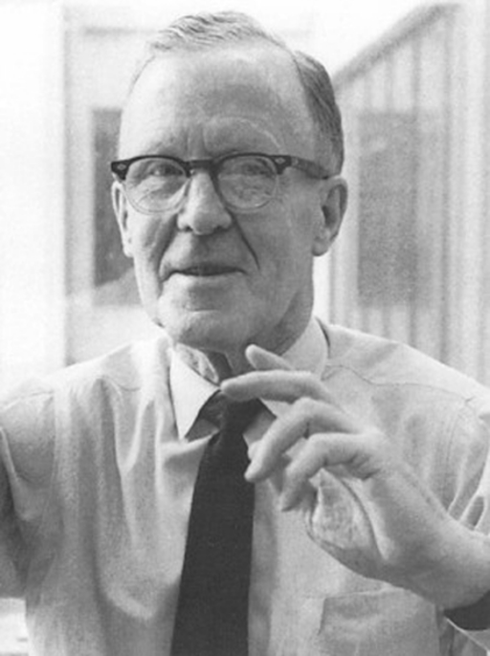
Neuron Excitement and Communication
“A large brain, like a large government, may not be able to do simple things in a simple way”
Donald O. Hebb (1904-1985), Psychologist and author of The Organization of Behavior The Organization of Behavior: http://bit.ly/38gfgBd
Described a model for brain-cell interaction
Theories on Neuron Excitement and Communication
‘Weights’ to describe neural interactions

Slide 3
Timeline
1957
Frank Rosenblatt invented ‘Mark 1 Perceptron’ aimed at image recognition. (http://bit.ly/33X9GjF)
1990s
With a focus on solving practical problems using neural networks, Machine Learning gained traction.
2000s
Democratization of Vision and Speech challenges and solutions – DARPA, LSTM, Deep Learning
2010s
Mass-reach via Enterprise and Consumer channels – Cognitive Services, Watson, AlphaGo, Siri, Cortana
2019
A focus on higher levels of abstraction via Auto-ML; focus on Ethics; bringing AI to the Edge.
Notes:
1957
Frank Rosenblatt combined research from Donald Hebb and Arthur Samuel.
1990s
. AI and ML went their separate ways in the 70s and 80s
. ML proved successful in the 90s by solving practical problems using algorithms working on vast datasets available on the internet
. AI contended ‘logic’ based solutions and ML went down the path of solving problems using algorithms
2000s
. DARPA autonomous vehicle challenge
. NLP
. Wall Street – quant related trading and fund management
2010s
. Mass media recognition with Watson, AlphaGo winning the championship 4 out of 5 times against Lee Se-Dol
. Enterprises had Cortana on their desktops
. Siri paved the way for digital assistants on the phone
. Alexa became a household name

Slide 4
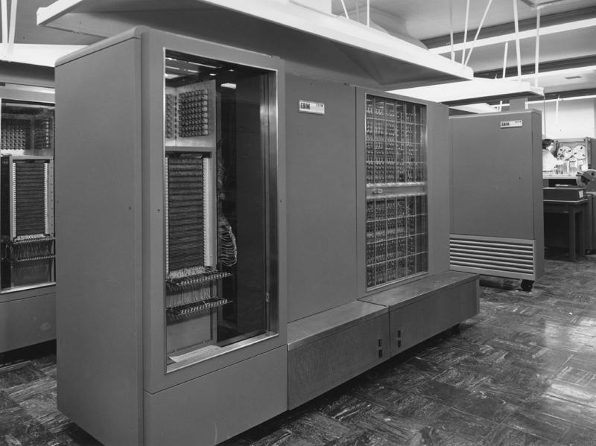
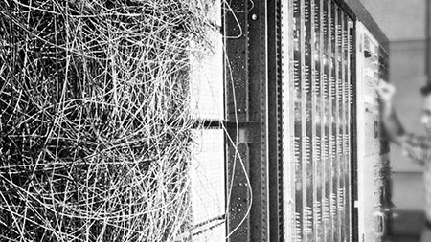
Notes:
1957
Frank Rosenblatt combined research from Donald Hebb and Arthur Samuel.
1990s
. AI and ML went their separate ways in the 70s and 80s
. ML proved successful in the 90s by solving practical problems using algorithms working on vast datasets available on the internet
. AI contended ‘logic’ based solutions and ML went down the path of solving problems using algorithms
2000s
. DARPA autonomous vehicle challenge
. NLP
. Wall Street – quant related trading and fund management
2010s
. Mass media recognition with Watson, AlphaGo winning the championship 4 out of 5 times against Lee Se-Dol
. Enterprises had Cortana on their desktops
. Siri paved the way for digital assistants on the phone
. Alexa became a household name

Slide 5
Timeline
1957
Frank Rosenblatt invented ‘Mark 1 Perceptron’ aimed at image recognition. (http://bit.ly/33X9GjF)
1990s
With a focus on solving practical problems using neural networks, Machine Learning gained traction.
2000s
Democratization of Vision and Speech challenges and solutions – DARPA, LSTM, Deep Learning
2010s
Mass-reach via Enterprise and Consumer channels – Cognitive Services, Watson, AlphaGo, Siri, Cortana
2019
A focus on higher levels of abstraction via Auto-ML; focus on Ethics; bringing AI to the Edge.
Notes:
1957
Frank Rosenblatt combined research from Donald Hebb and Arthur Samuel.
1990s
. AI and ML went their separate ways in the 70s and 80s
. ML proved successful in the 90s by solving practical problems using algorithms working on vast datasets available on the internet
. AI contended ‘logic’ based solutions and ML went down the path of solving problems using algorithms
2000s
. DARPA autonomous vehicle challenge
. NLP
. Wall Street – quant related trading and fund management
2010s
. Mass media recognition with Watson, AlphaGo winning the championship 4 out of 5 times against Lee Se-Dol
. Enterprises had Cortana on their desktops
. Siri paved the way for digital assistants on the phone
. Alexa became a household name

Slide 6
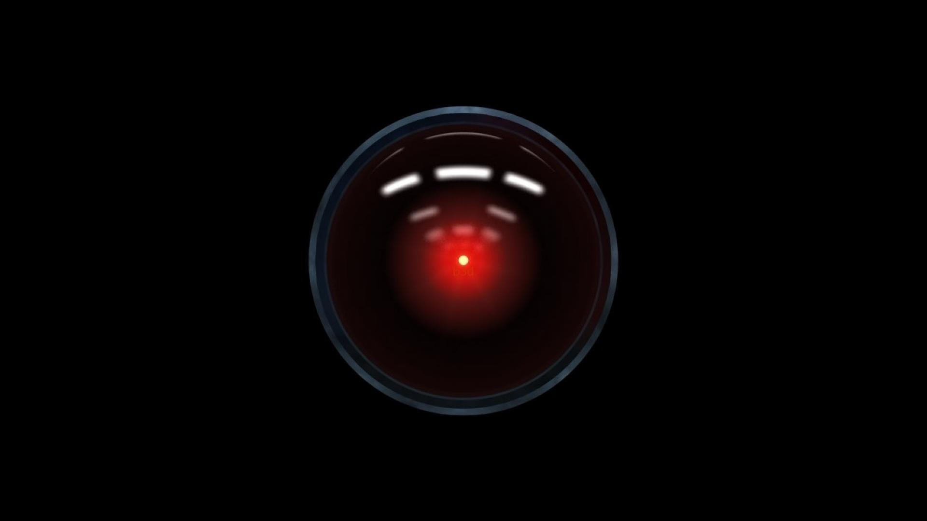
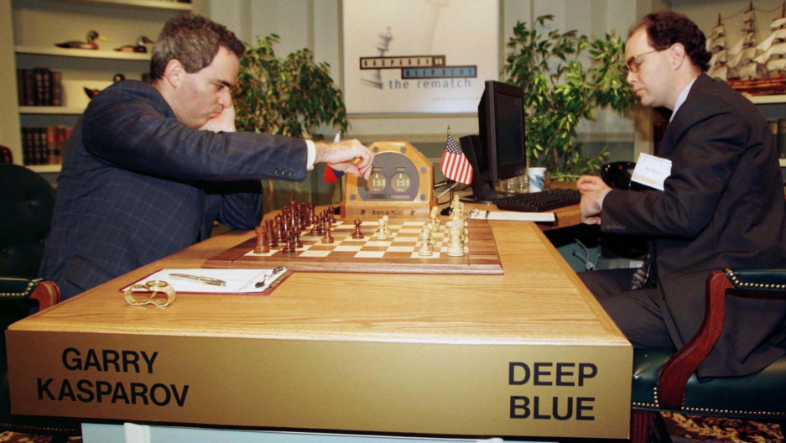

Notes:
1957
Frank Rosenblatt combined research from Donald Hebb and Arthur Samuel.
1990s
. AI and ML went their separate ways in the 70s and 80s
. ML proved successful in the 90s by solving practical problems using algorithms working on vast datasets available on the internet
. AI contended ‘logic’ based solutions and ML went down the path of solving problems using algorithms
2000s
. DARPA autonomous vehicle challenge
. NLP
. Wall Street – quant related trading and fund management
2010s
. Mass media recognition with Watson, AlphaGo winning the championship 4 out of 5 times against Lee Se-Dol
. Enterprises had Cortana on their desktops
. Siri paved the way for digital assistants on the phone
. Alexa became a household name

Slide 7
Timeline
1957
Frank Rosenblatt invented ‘Mark 1 Perceptron’ aimed at image recognition. (http://bit.ly/33X9GjF)
1990s
With a focus on solving practical problems using neural networks, Machine Learning gained traction.
2000s
Democratization of Vision and Speech challenges and solutions – DARPA, LSTM, Deep Learning
2010s
Mass-reach via Enterprise and Consumer channels – Cognitive Services, Watson, AlphaGo, Siri, Cortana
2019
A focus on higher levels of abstraction via Auto-ML; focus on Ethics; bringing AI to the Edge.
Notes:
1957
Frank Rosenblatt combined research from Donald Hebb and Arthur Samuel.
1990s
. AI and ML went their separate ways in the 70s and 80s
. ML proved successful in the 90s by solving practical problems using algorithms working on vast datasets available on the internet
. AI contended ‘logic’ based solutions and ML went down the path of solving problems using algorithms
2000s
. DARPA autonomous vehicle challenge
. NLP
. Wall Street – quant related trading and fund management
2010s
. Mass media recognition with Watson, AlphaGo winning the championship 4 out of 5 times against Lee Se-Dol
. Enterprises had Cortana on their desktops
. Siri paved the way for digital assistants on the phone
. Alexa became a household name

Slide 8

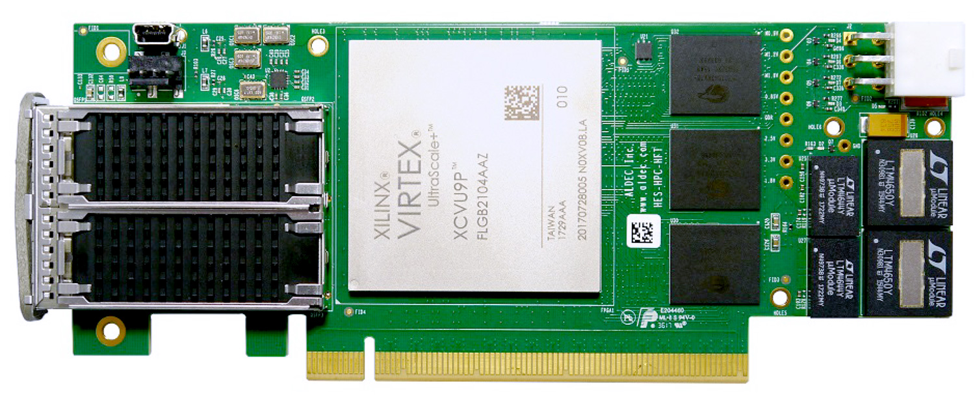
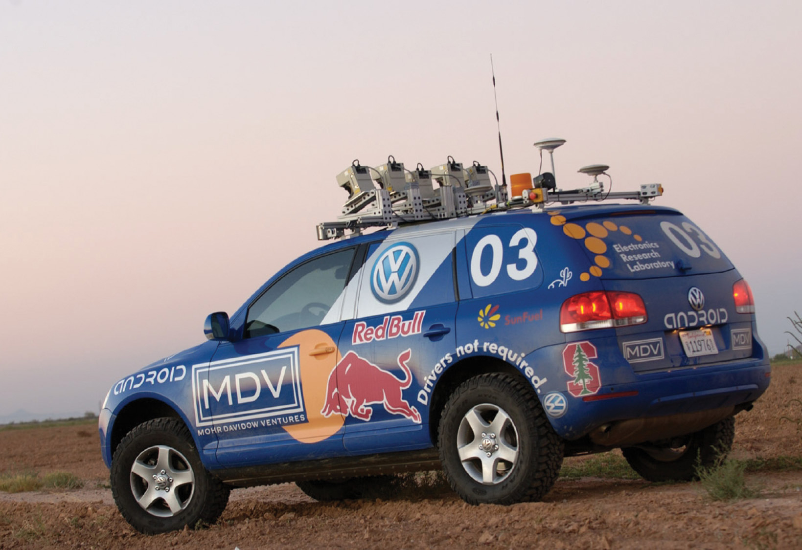

Slide 9
Timeline
1957
Frank Rosenblatt invented ‘Mark 1 Perceptron’ aimed at image recognition. (http://bit.ly/33X9GjF)
1990s
With a focus on solving practical problems using neural networks, Machine Learning gained traction.
2000s
Democratization of Vision and Speech challenges and solutions – DARPA, LSTM, Deep Learning
2010s
Mass-reach via Enterprise and Consumer channels – Cognitive Services, Watson, AlphaGo, Siri, Cortana
2019
A focus on higher levels of abstraction via Auto-ML; focus on Ethics; bringing AI to the Edge.
Notes:
1957
Frank Rosenblatt combined research from Donald Hebb and Arthur Samuel.
1990s
. AI and ML went their separate ways in the 70s and 80s
. ML proved successful in the 90s by solving practical problems using algorithms working on vast datasets available on the internet
. AI contended ‘logic’ based solutions and ML went down the path of solving problems using algorithms
2000s
. DARPA autonomous vehicle challenge
. NLP
. Wall Street – quant related trading and fund management
2010s
. Mass media recognition with Watson, AlphaGo winning the championship 4 out of 5 times against Lee Se-Dol
. Enterprises had Cortana on their desktops
. Siri paved the way for digital assistants on the phone
. Alexa became a household name

Slide 10
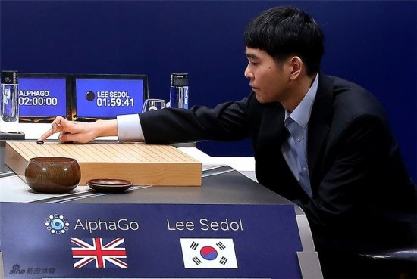
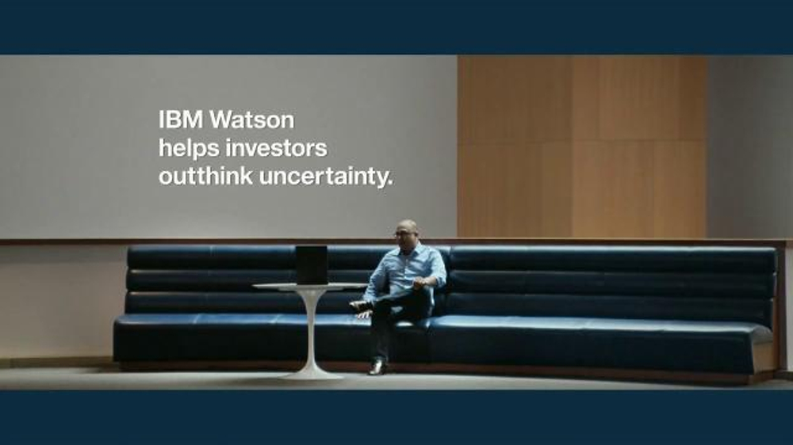
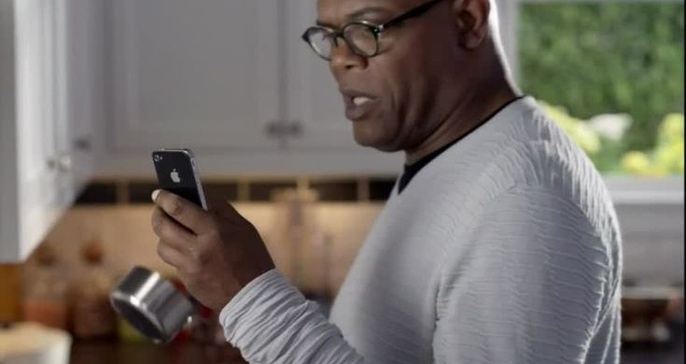
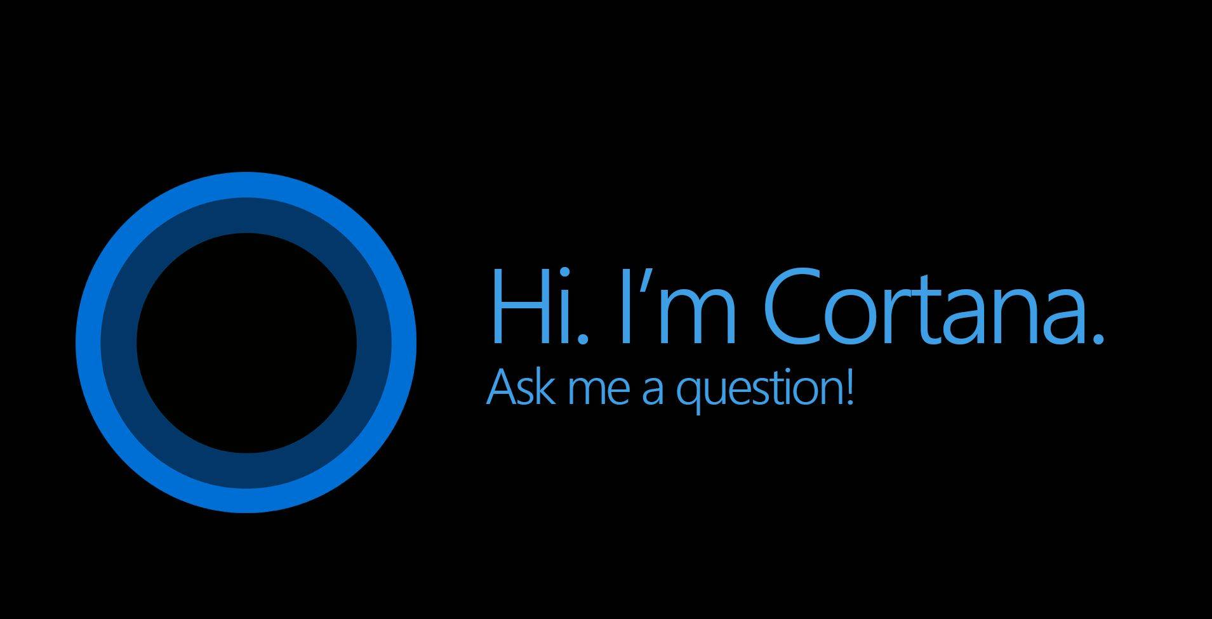
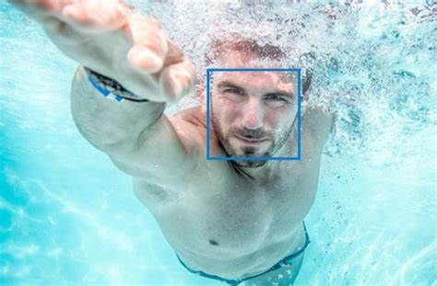

Slide 11
Timeline
1957
Frank Rosenblatt invented ‘Mark 1 Perceptron’ aimed at image recognition. (http://bit.ly/33X9GjF)
1990s
With a focus on solving practical problems using neural networks, Machine Learning gained traction.
2000s
Democratization of Vision and Speech challenges and solutions – DARPA, LSTM, Deep Learning
2010s
Mass-reach via Enterprise and Consumer channels – Cognitive Services, Watson, AlphaGo, Siri, Cortana
2019
A focus on higher levels of abstraction via Auto-ML; focus on Ethics; bringing AI to the Edge.
Notes:
1957
Frank Rosenblatt combined research from Donald Hebb and Arthur Samuel.
1990s
. AI and ML went their separate ways in the 70s and 80s
. ML proved successful in the 90s by solving practical problems using algorithms working on vast datasets available on the internet
. AI contended ‘logic’ based solutions and ML went down the path of solving problems using algorithms
2000s
. DARPA autonomous vehicle challenge
. NLP
. Wall Street – quant related trading and fund management
2010s
. Mass media recognition with Watson, AlphaGo winning the championship 4 out of 5 times against Lee Se-Dol
. Enterprises had Cortana on their desktops
. Siri paved the way for digital assistants on the phone
. Alexa became a household name

Slide 12
Digital Transformation
Deeper Relationships
More efficient ops
Rise of the ‘Intelligent System’
Optimize operations
The digital feedback loop
Customer signal
a
Operational Data
Data + intelligence
1
Data: Capture digital signal across business
Employee feedback
Product Telemetry
2
More effective employees
Better products
Insight: Connect and synthesize data
3
Action: Improve business outcomes
Transform products

Slide 13
AI In Mainstream
Why is AI so *hot* right now?
More data
More compute
Innovation in algorithms, tools, and frameworks

Slide 14
Data reality
Data + intelligence
Notes:
As we all know, data volumes are exploding…. Some estimate it’ll reach 44ZB by 2020!

Slide 15
Modern Data Estate
Operational databases
Operational databases
Data warehouses
Data warehouses
Data lakes
Data lakes

Slide 16
Modern Data Estate
Operational databases
Operational databases
Data warehouses
Data warehouses
Data lakes
Data lakes

Slide 17
Modern Data Estate
AI
BI
Operational databases
|
|
Operational databases
Data warehouses
Data warehouses
Data lakes
Data lakes

Slide 18
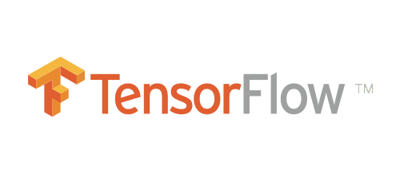
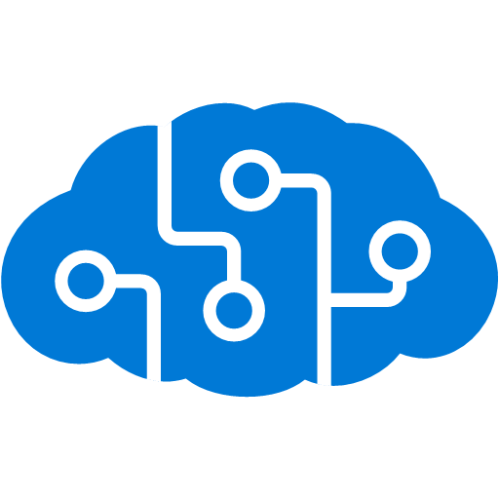



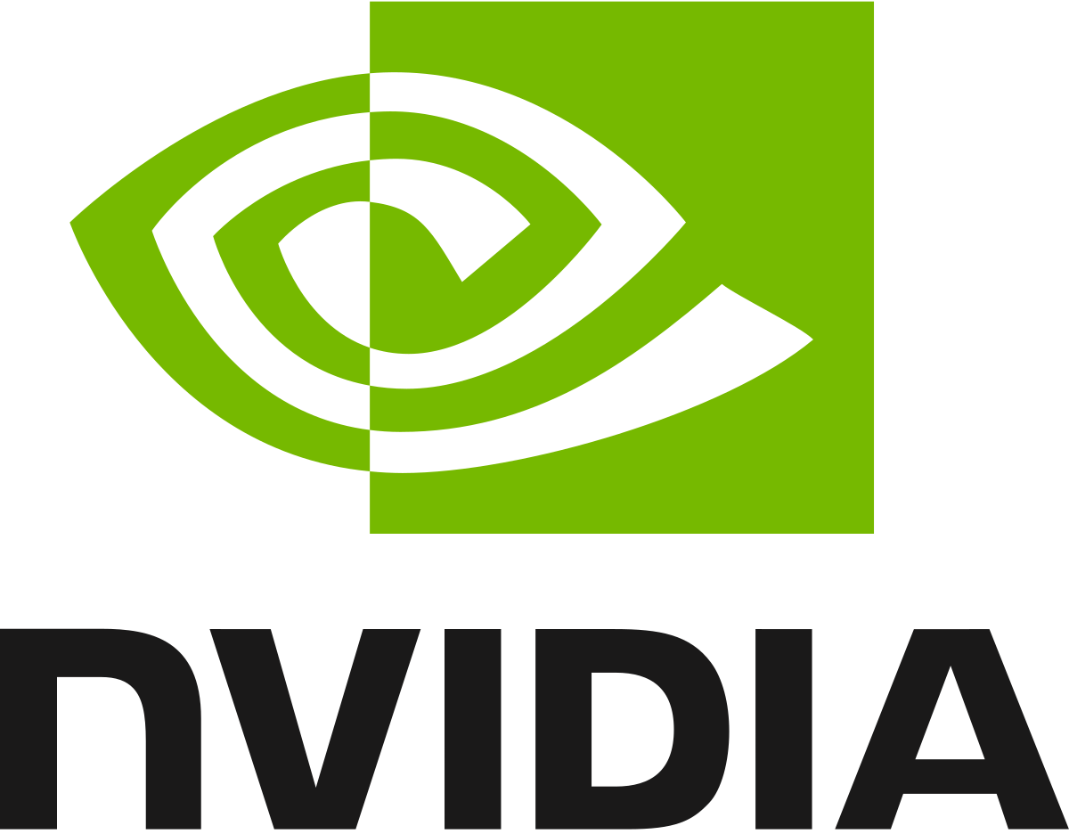
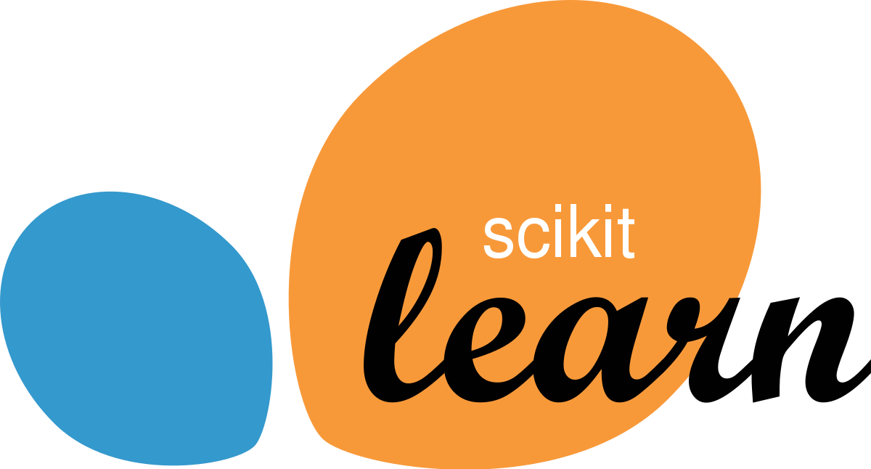


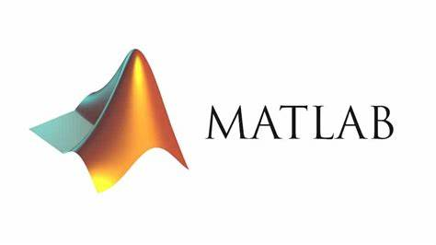






MILL5 and Machine Learning

Slide 19



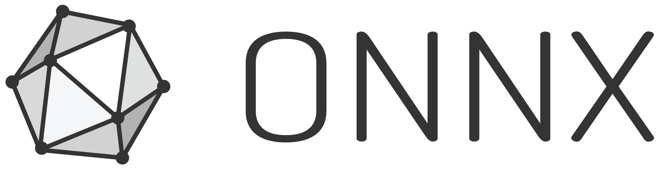

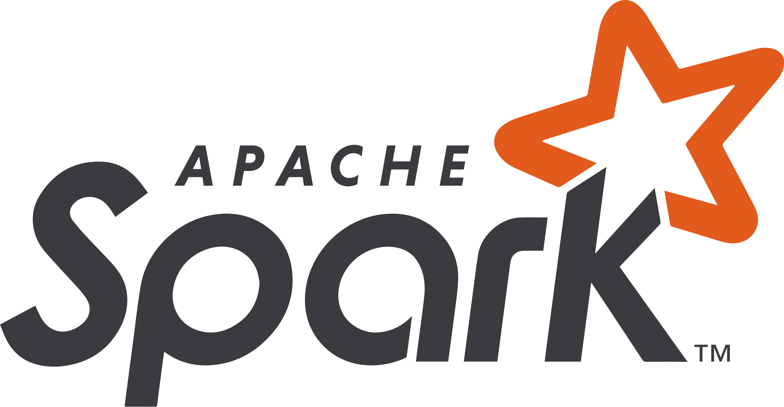
Azure for AI
Why Microsoft Azure for AI
Accelerate time to value with agile tools and services
Innovate with AI everywhere – in the cloud, at edge, and on-premises
Pretrained AI services
Powerful tools
Comprehensive platform
Cloud
Edge
On-premises
Use any language, any development tool and any framework
Benefit from industry-leading security, privacy, compliance, transparency, and AI ethics standards
>90% of Fortune 500 companies use Microsoft Cloud

Slide 20






Azure Landscape
Machine Learning Solutions in Microsoft Azure
Data
AI
Modern BI
BI
a
Data modernization on-premises
a
a
AI apps & agents
Self-service BI
b
Data modernization to Azure
b
b
Knowledge mining
On-premises BI
c
Globally distributed data
c
c
Apps with intelligence
Machine learning
d
Cloud scale analytics
Notes:
Data
. Tools like SQL Server, SQL Analysis Services, Polybase, Machine Learning Server, Azure Stack running ML workloads
. Similar tools and more in Azure – Data Lakes, Spark, HDInsight, and more
. Several regions and zones
. Petabyte scale recently highlighted with Azure Synapse at Ignite
AI
. AI apps like Cognitive Services and BOT are available to quickly build Decision Support, Language, Speech, Vision, or Web Search based applications
. You can also customize cognitive solutions to your own data needs with speech fonts, custom vision, and more
. Knowledge mining applies AI to documents to do things like Key Phrase extraction, Entity extraction for Location or Organizational Identified terms, Sentiment Analysis, Language Detection, Tag Extraction, Custom Skills, etc.
Machine Learning
. Leverage pretrained models
. Build deep learning solutions using popular frameworks like TensorFlow, Pytorch, Keras, and more
. Make your models portable by exporting them to Onnx
. Inject ML into your services via Databricks, Azure ML
. Execute on varied infrastructure – CPUs, GPUs, FPGAs
. Deploy in governed environments using MLOps – DevOps for ML

Slide 21


Azure AI
a
b
c
AI apps & agents
Knowledge mining
Machine learning
Azure Bot Service
Azure Cognitive Services
Azure Cognitive Search
Azure Databricks
Azure Machine Learning
Azure AI Infrastructure

Slide 22

Azure AI
a
b
c
AI apps & agents
Knowledge mining
Machine learning
Azure Bot Service
Azure Cognitive Services
Azure Cognitive Search
Azure Databricks
Azure Machine Learning
Azure AI Infrastructure

Slide 23



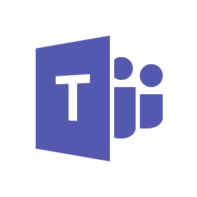
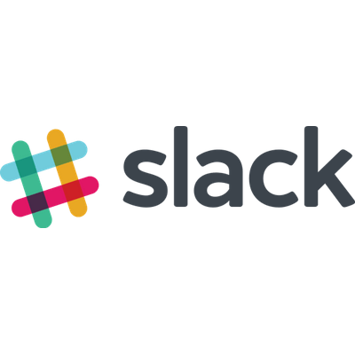



Azure AI Apps & Agents
a
b
c
AI apps & agents
Knowledge mining
Machine learning
Cognitive services
Bot service
Infuse your apps with powerful, pre-trained AI models
Customize easily and tailor to your needs
Use language of your choice
Accelerate bot development with an integrated environment and pre-built templates
Engage your audience easily across multiple channels
Decision
Language
Speech
Vision
Web Search

Slide 24

Azure AI
b
a
c
AI apps & agents
Knowledge mining
Machine learning
Azure Bot Service
Azure Cognitive Services
Azure Cognitive Search
Azure Databricks
Azure Machine Learning
Azure AI Infrastructure

Slide 25


Azure Knowledge Mining
Azure AI
b
a
c
AI apps & agents
Knowledge mining
Machine learning
Unlock valuable information lying latent in all your content
Form 5471
Your business documents
Azure Bot Service
Azure Cognitive Services
Azure Cognitive Search
Azure Databricks
Azure Machine Learning
Azure AI Infrastructure

Slide 26

Azure Knowledge Mining
b
a
c
AI apps & agents
Knowledge mining
Machine learning
What does Knowledge Mining do?
Documents
Cutting-edge AI
Fully text- searchable rich index
Key phrase extraction
Location entity extraction
Sentiment analysis
Custom skills
Organization entity extraction
Persons entity extraction
Language detection
Landmark detection
Face detection
Celebrity recognition
Tag extraction
Printed text recognition

Slide 27
Azure AI
c
a
b
AI apps & agents
Knowledge mining
Machine learning
Azure Bot Service
Azure Cognitive Services
Azure Cognitive Search
Azure Databricks
Azure Machine Learning
Azure AI Infrastructure

Slide 28







Machine Learning
Azure AI
c
a
b
AI apps & agents
Knowledge mining
Machine learning
Sophisticated pretrained models
To simplify solution development
Vision
Speech
Language
Search
Popular frameworks
To build advanced deep learning solutions
Pytorch
TensorFlow
Keras
Onnx
Productive services
To empower data science and development teams
Azure Databricks
Azure Machine Learning
Machine Learning VMs
Powerful infrastructure
To accelerate deep learning
CPU
GPU
FPGA
Flexible deployment
To deploy, manage models on intelligent cloud & edge
On-premises
Cloud
Edge
Azure Bot Service
Azure Cognitive Services
Azure Cognitive Search
Azure Databricks
Azure Machine Learning
Azure AI Infrastructure

Slide 29
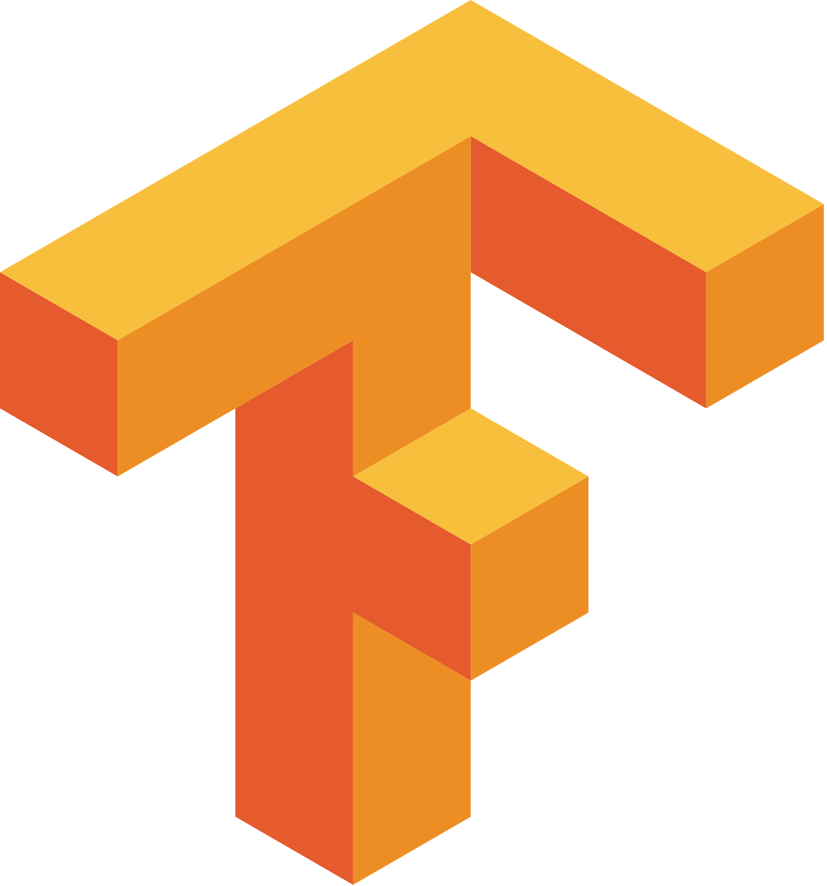
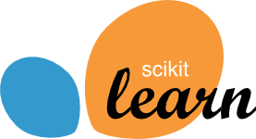



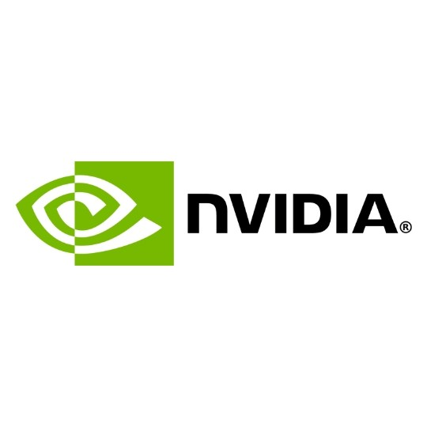



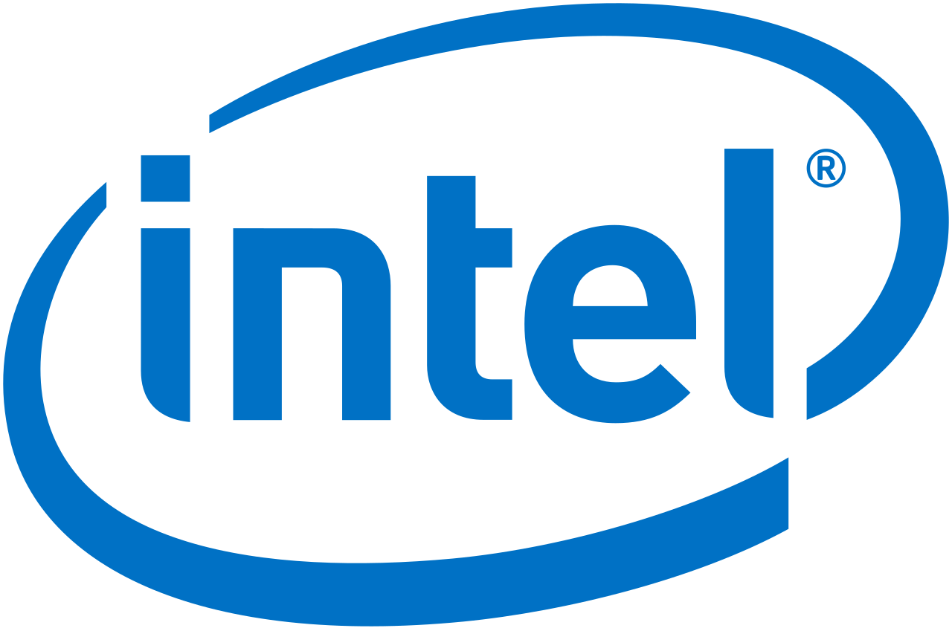

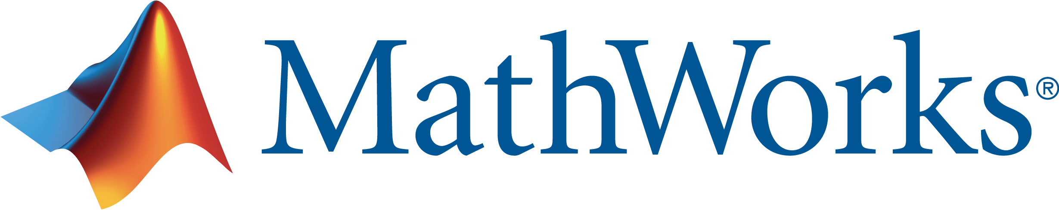


Popular Frameworks
c
a
b
AI apps & agents
Knowledge mining
Machine learning
Build deep learning solutions
Use your favorite deep learning frameworks
Without getting locked into one framework
TensorFlow
PyTorch
Scikit-Learn
Community project created by Facebook and Microsoft
Use the best tool for the job. Train in one framework and transfer to another for inference
MXNet
Chainer
Keras

Slide 30


Productive Services
c
a
b
AI apps & agents
Knowledge mining
Machine learning
Empower data science and development teams
Azure Databricks
Azure Machine Learning
Machine Learning VMs
Integrated data science & data engineering teams
Desktop solutions not adequate
Need a unified big data & machine learning solution
Individual data scientists
Desktop solutions adequate
Need cloud for sporadic compute needs

Slide 31
Productive Services
c
a
b
AI apps & agents
Knowledge mining
Machine learning
Empower data science and development teams
Azure Databricks
Azure Machine Learning
Enable collaboration between data scientists and data engineers with an interactive productive workspace
Prepare and clean data at massive scale with the language of your choice
Build and train models with pre-configured machine learning and deep learning optimized clusters
Track experiments for reproducibility and auditing needs
Identify and promote your best models
Deploy and manage your models using containers to run them anywhere

Slide 32
Powerful Infrastructure
c
a
b
AI apps & agents
Knowledge mining
Machine learning
Accelerate Deep Learning
CPUs
GPUs
FPGAs
General purpose machine learning
D, F, L, M, H Series
Deep learning
N Series
Specialized hardware accelerated deep learning
Project Brainwave
Optimized for flexibility
Optimized for performance

Slide 33
Flexible Deployment
c
a
b
AI apps & agents
Knowledge mining
Machine learning
Deploy and manage models on cloud and edge
Train & deploy
Train & deploy
Track models in production
Capture model telemetry
Retrain models automatically
Deploy

Slide 34
Azure Machine Learning
Azure AI
c
a
b
AI apps & agents
Knowledge mining
Machine learning
Sophisticated pretrained models
To simplify solution development
Vision
Speech
Language
Search
Popular frameworks
To build advanced deep learning solutions
Pytorch
TensorFlow
Keras
Onnx
Productive services
To empower data science and development teams
Azure Databricks
Azure Machine Learning
Machine Learning VMs
Powerful infrastructure
To accelerate deep learning
CPU
GPU
FPGA
Flexible deployment
To deploy, manage models on intelligent cloud & edge
On-premises
Cloud
Edge
Azure Bot Service
Azure Cognitive Services
Azure Cognitive Search
Azure Databricks
Azure Machine Learning
Azure AI Infrastructure

Slide 35
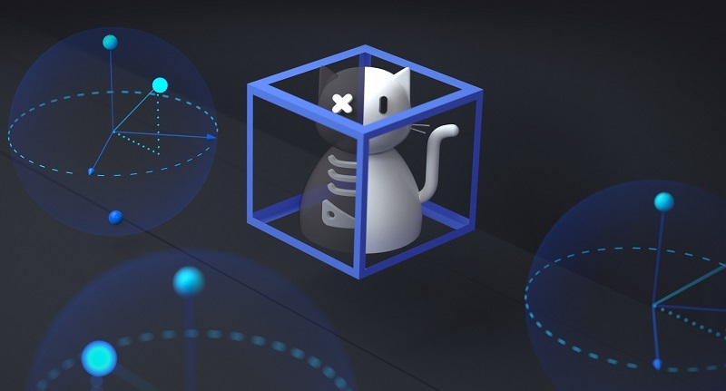


Future of Machine Learning and AI
Performance
Principles
Quantum
Quantum
Improvements to algorithms and platforms to support faster training, inference, and streamlined operations
Responsible AI – Fairness, Safety, Privacy and Security, Inclusiveness, Transparency, and Accountability
Development in hardware and solutions to provide pre-built solvers and algos that run at industry-scale

Slide 36
Schedule for today
Custom Vision with Azure Vision Services – Dave Davis from MILL5
How to easily and quickly get started with several of Azure's AI Cognitive Services - Daniel Colon from Microshare
Jump Start Azure Databricks - Bryan Cafferky from Microsoft
Bot in an Hour, an Intro to the Virtual Assistant Template - Jim Wilcox from Insight Digital Innovations

Slide 37
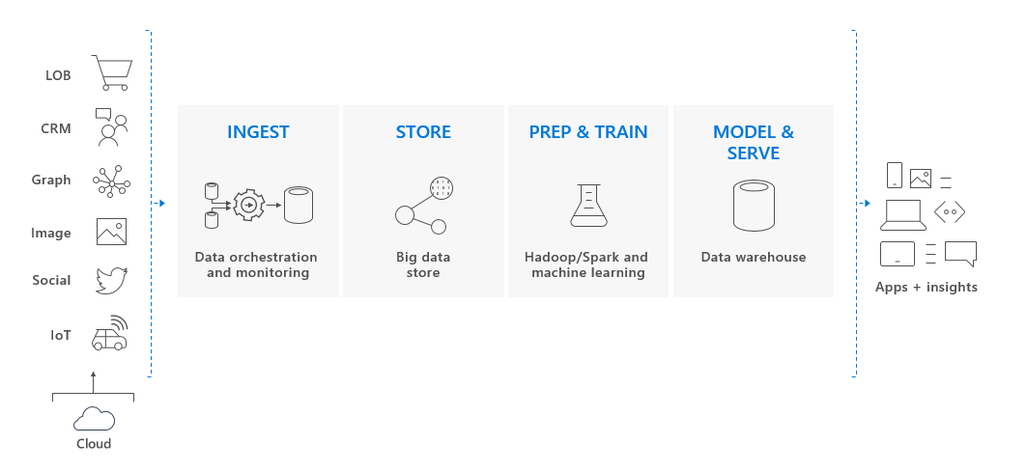
Azure Synapse

Slide 38

Looking Ahead
“It’s not just about what it is… it’s about what it can become”
Once-ler, circa 1971

Slide 39

Thank you.
Shri Bhupathi Founder, Technical Fellow
shri@mill5.com | 617.797.7640
www.mill5.com
200 Portland St.,
Boston, MA 02114
BOSTON COLOMBIA UKRAINE

